Slide 1
CSC-257 Theory Of Computation (BSc CSIT, TU)
Ganesh Khatri
kh6ganesh@gmail.com

Slide 2
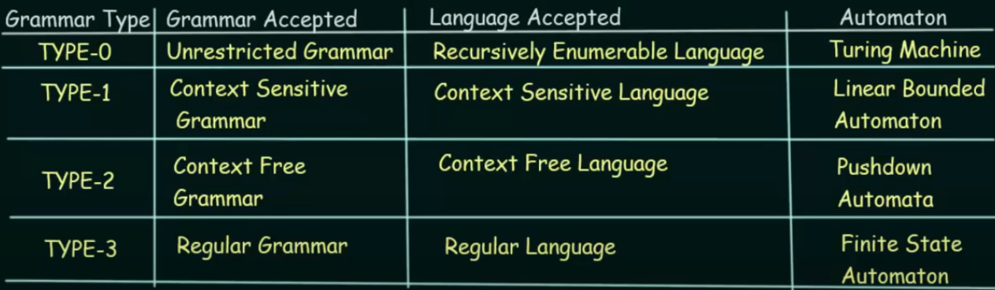
Chomsky Hierarchy of Grammars

Slide 3
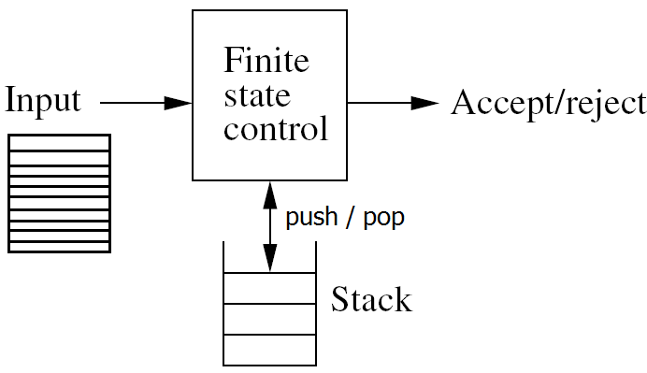
Push Down Automata (PDA)
The context free languages can also be defined or represented by some automaton which is called Push Down automaton.
PDA can be thought of as an Є-NFA with the addition of stack.
The presence of a stack means that, the pushdown automata can remember infinity amount of information.
PDA can only access the information on its stack in a Last-In-First-Out(LIFO) order.
We can define PDA informally as device shown in figure

Slide 4
Push Down Automata (PDA)
PDA is an abstract machine determined by following three things :
Input Tape
Finite State Control
A Stack with infinite size
Each moves of the machine is determined by three things :
The current state
Next input symbol
Symbol on the top of stack
The moves consist of :
Changing state | staying on same state
Replacing the stack top by string of zero or more symbols

Slide 5
Push Down Automata (PDA)
Popping the top symbol of the stack means replacing it by Є
Pushing Y on the stack means replacing stack’s top, say X, by YX
The single move of machine contains only one stack operation either push or pop.
A DFA can remember a finite amount of information, but a PDA can remember an infinite amount of information

Slide 6
Push Down Automata (PDA) : Forma Definition
A PDA is defined by seven tuples (Q, Σ, Г, δ, q₀, z₀, F) where,
Q - Finite set of states
Σ - Finite set of input symbols | alphabets
Г - Finite set of stack alphabet
q₀- Start state of PDA; q₀ ε Q
z₀ - Initial stack symbol; z₀ ε Г
F - Set of final states; F ε Q
δ - Transition function that maps Q × (Σ U {Є}) × Г → Q × Г*

Slide 7
Push Down Automata (PDA) : Forma Definition
As for finite automata, δ governs the behavior of PDA. Formally, δ takes as argument a triple δ(q, a, X) where
‘q’ is a state
‘a is either an input symbol in Σ or Є. ( note Є does not belong to Σ)
X is a stack symbol
The output of δ is a finite set of pairs (p, γ), where p is the new state and γ is the string on the stack after transition.
i.e the moves of PDA can be interpreted as :
δ(q, a, X) = {(p₁, γ₁) (p₂, γ₂) ………. (p_{m}, γ_{m})} here q, p_{i} ε Q, a ε ΣUЄ & X ε Г, γ_{i} ε Г*

Slide 8
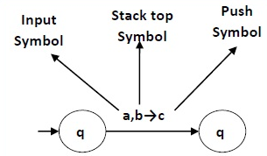
Push Down Automata (PDA) : Graphical Notation
We can use transition diagram to represent a PDA, where :
Any state is represented by a node in graph (diagram)
Any arc labeled with ‘start’ indicates the start state and doubly circled states are accepting / final states
The arc corresponds to transition of PDA as :
arc labeled as a, x | α means transition δ(q,a,x) = (p,α) for arc from state p to q

Slide 9
Push Down Automata (PDA) : Graphical Notation
Example : A PDA accepting a string over {a, b} such that number of a’s and b’s are equal. i.e. L = {w | w ε {a, b}* and a’s and b’s are equal}.
The PDA that accepts the above language can be constructed using the idea that the PDA should push the input symbol if the top of the stack symbol is same as it otherwise Pop the stack.
For this, let us construct a PDA as :
P = {Q, Σ, Г, δ, q₀, z₀, F} be the PDA recognizing the given language. where, let us suppose
Q = { q0, q1, q2 }
Σ = {a, b}
Г = {a, b, z0}
z0 = z0
q0 = q0
F = { q2 }

Slide 10
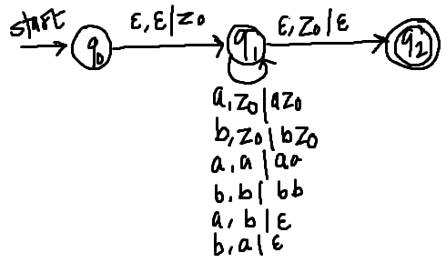
Push Down Automata (PDA) : Graphical Notation
Now δ is defined as :
δ(q0, Є, Є) = (q1, z0) //initialize stack with Є to indicate the bottom of stack
δ(q1, a, z0) = (q1, az0)
δ(q1, b, z0) = (q1, bz0)
δ(q1, a, a) = (q1, aa)
δ(q1, b, b) = ( q1, bb)
δ(q1, a, b) = (q1, Є)
δ(q1, b, a) = (q1, Є)
δ(q1, Є, z0) = (q2, Є)
// last line indicates the acceptance of string

Slide 11
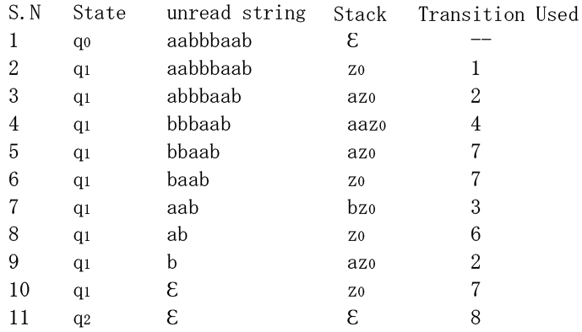
Push Down Automata (PDA) : Graphical Notation
Let us trace for w= aabbbaab
Finally we have reached state q2. Hence accepted

Slide 12
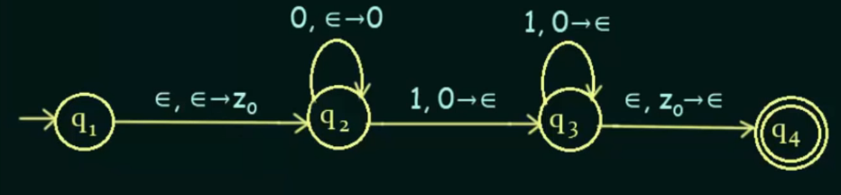
Push Down Automata (PDA) : Graphical Notation
Exercise 1 : Construct a PDA that accepts L = { 0^{n}1^{n} | n >=0 }
https://www.youtube.com/watch?v=eY7fwj5jvC4

Slide 13
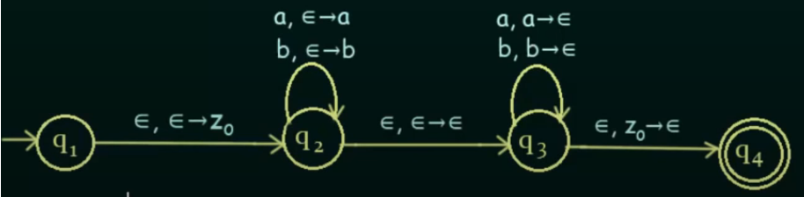
Push Down Automata (PDA) : Graphical Notation
Exercise 2 : Construct a PDA that accepts even palindromes of the form L = { ww^{R} | w = (a+b)⁺ } [ accepting strings : abba, aba, baab etc ]
https://www.youtube.com/watch?v=TEQcJybMMFU

